Slide 1
OOP
Inheritance, association ( composition and aggregation)
Using python3

Slide 2
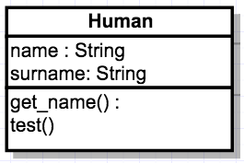
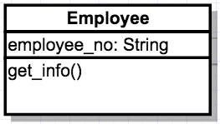
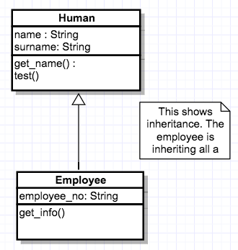
Inheritance
Parent Class
Child Class
Enables code re-use
Put all the common functionalities into one class
Specific functionalities in the other class
UML diagram showing inheritance

Slide 3
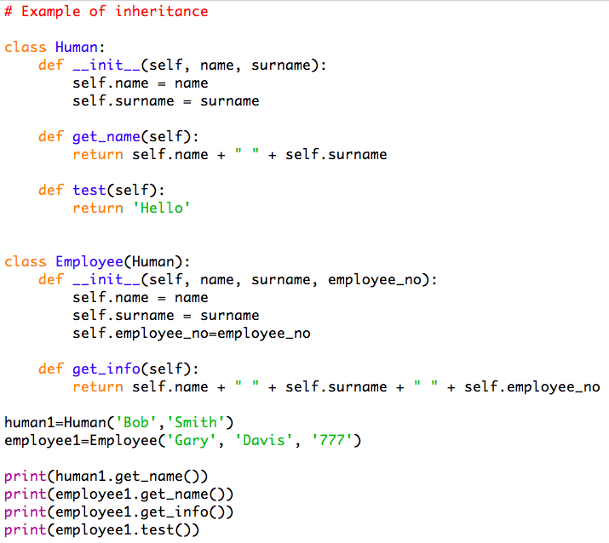

Inheritance
The employee class inherits all the attributes and methods of the parent class ‘Human’
This is not the best way as the aim to to decrease repetition
output
Notes:
As you can see the employee can use the methods from the parent class

Slide 4
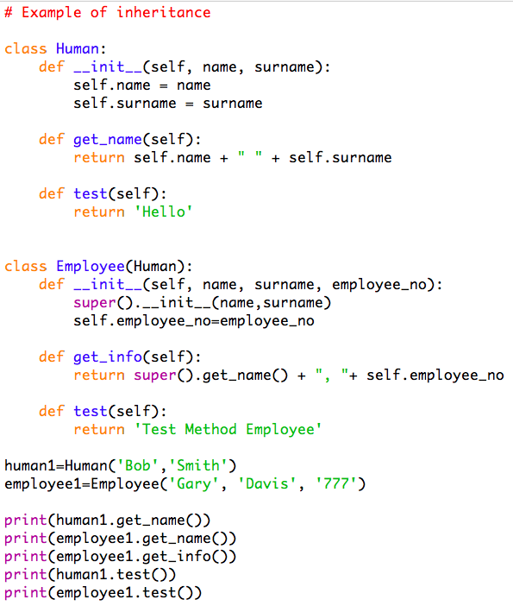
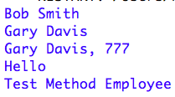
Inheritance & polymorphism
Use super to inherit the attributes of the parent class
Use super to use the methods of the parent class in the child class
output
Polymorphism – overwrite the methods in the parent class
Notes:
Use super instead of rewriting the code from the parent class by using super
Polymorphism-overwrite the method in the parent class (test method)

Slide 5
Composition and aggregation
Association
Inheritance
Composition
1
Human
Body parts
Human
1..*
HAS A
Is a
Made up of or is part of
Aggregation
Employer
1..0
Team
Players
1..*
Notes:
Association:
There is some kind of interaction with another object. Relationship between classes
both objects use each other
Both Aggregation and composition are forms of association. They both describe a relationship between a whole and its parts
Composition: is a more specific kind of aggregation that implies ownership. A human can live without body parts but body parts cannot exist with a human. When a human dies all their body parts dies as well. Lifetime of both the objects are the same. The part can only belong to one whole. If the whole is destroyed then the part is destroyed
Aggregation: is a weak form of composition. A team is a collection of players and if the team is dissolved the players can still exist relationship is shown with the open diamond on the whole part of the relationship. The symbol says one or more players are part of a team.

Slide 6




Composition and aggregation
A team is made up of players
A player is part of a team
A building is made up of rooms
A room is part of a building
A band is made up of musicians
A musician is part of a band
A department is made up of teachers
A teacher is part of a department

Slide 7
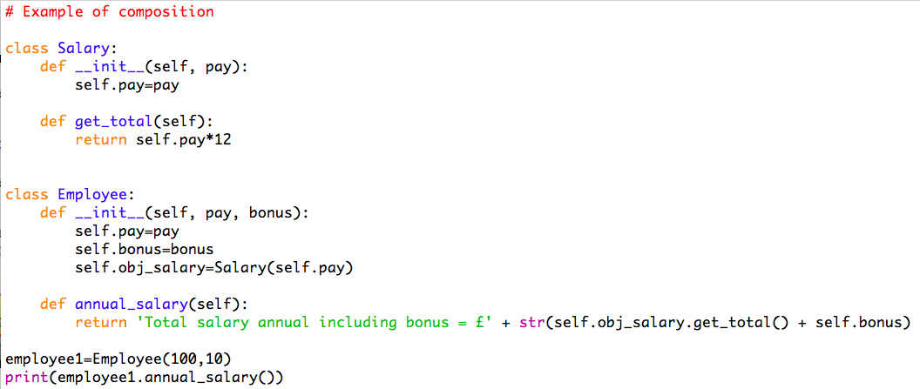
Composition example
Create an instance of the Salary class in the Employee class
this instance uses the method in the Salary class to get the total
Create an instance of the Employee class
Notes:
If you destroy the employee, the salary is also destroyed

Slide 8
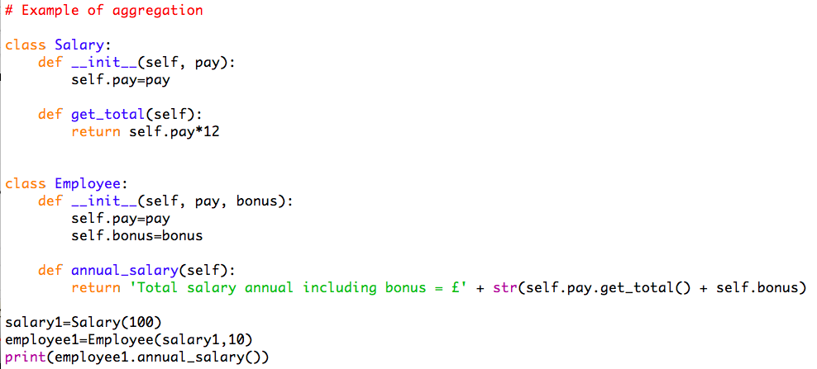
Aggregation example
The total is worked out by calling a method from the Salary class
Create an instance of the salary class
Create an instance of the employee class that uses the salary instance created earlier
Notes:
Not much difference
An instance of the class salary can exist independently

